Slide 1
Last lecture summary

Slide 2
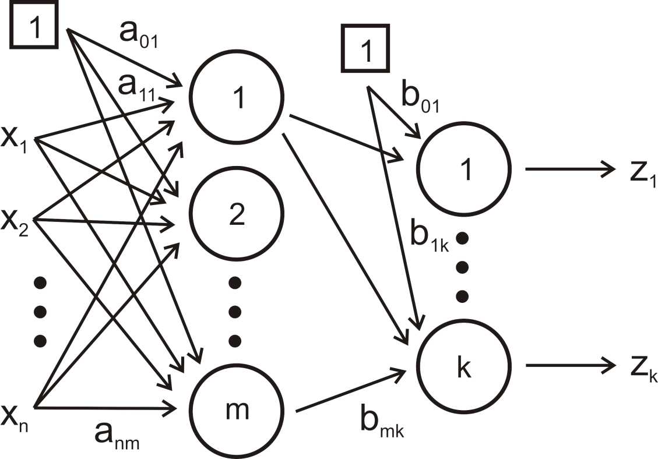
Multilayer perceptron
MLP, the most famous type of neural network
input layer
hidden layer
output layer

Slide 3
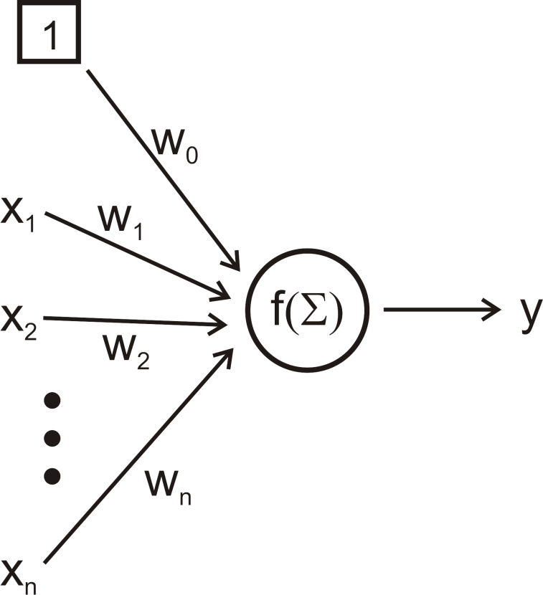
Processing by one neuron
bias
activation function
output
weights
inputs

Slide 4
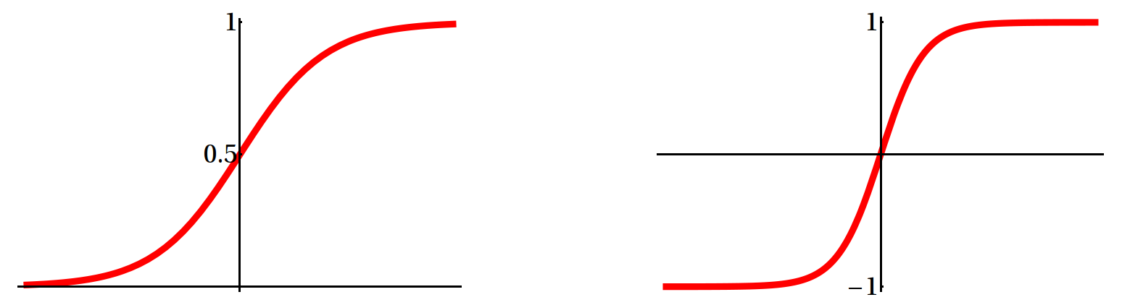
Nonlinear activation functions
logistic (sigmoid, unipolar)
tanh (bipolar)

Slide 5
Backpropagation training algorithm
MLP is trained by backpropagation.
forward pass
present a training sample to the neural network
calculate the error (MSE) in each output neuron
backward pass
first calculate gradient for hidden-to-output weights
then calculate gradient for input-to-hidden weights
the knowledge of grad_{hidden-output} is necessary to calculate grad_{input-hidden}
update the weights in the network
Notes:
- backpropagation – based on steepest decent
- beta … learning rate

Slide 6
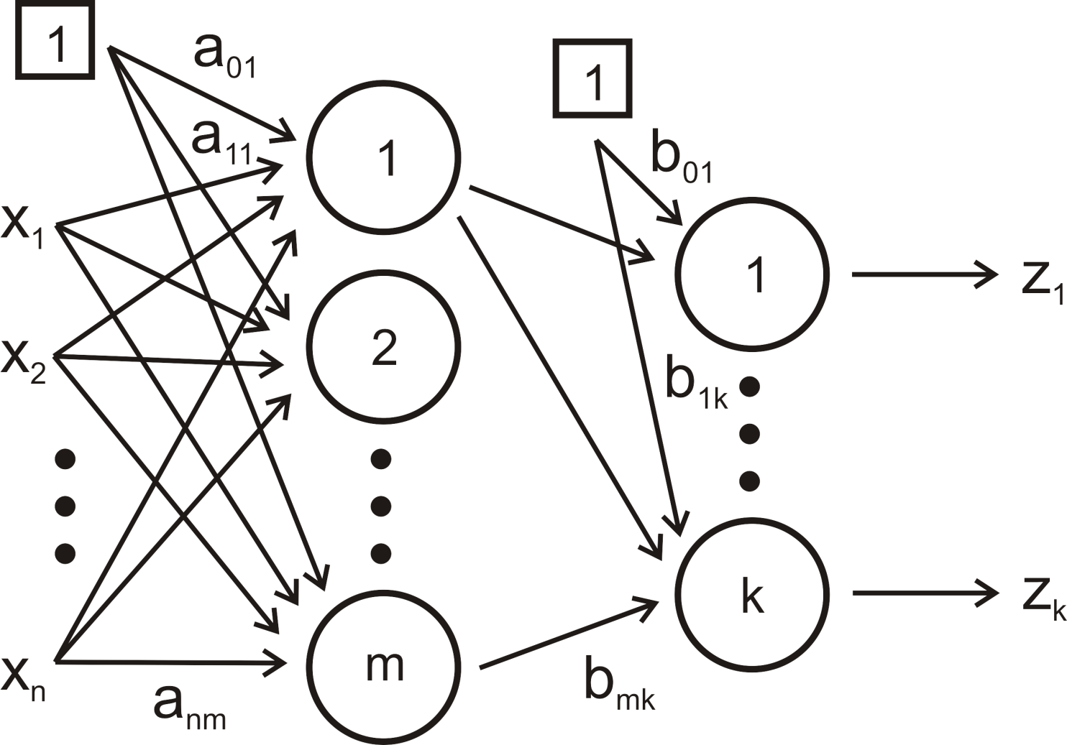
input signal propagates forward
error propagates backward

Slide 7
Radial Basis Function Networks (new stuff)

Slide 8
Radial Basis Function (RBF) Network
Becoming an increasingly popular neural network.
Is probably the main rival to the MLP.
Completely different approach by viewing the design of a neural network as an approximation problem in high-dimensional space.
Uses radial functions as activation function.

Slide 9
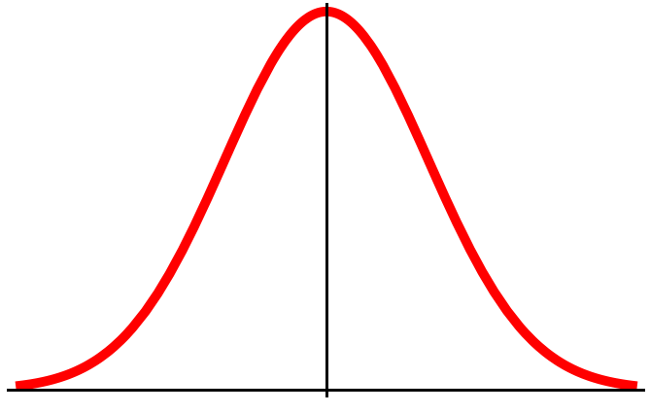
Gaussian RBF
Typical radial function is the Gaussian RBF (monotonically decreases with distance from the center).
Their response decreases with distance from a central point.
Parameters:
center c
width (radius r)
r
radius
c - center

Slide 10
Local vs. global units
Local
they cover just certain part of the space
i.e. they are nonzero just in certain part of the space
Global
sigmoid, linear
Local
Gaussian
Notes:
- Gaussian is local function

Slide 11
MLP
RBF
Pavel Kordík, Data Mining lecture, FEL, ČVUT, 2009
Notes:
classification using global (MLP) and local (RBF) units

Slide 12
RBFN architecture
Each of n compo-nents of the input vector x feeds forward to m basis functions whose outputs are linearly combined with weights w (i.e. dot product x∙w) into the network output f(x).
no weights
x₁
h₁
h₂
W₁
x₂
W₂
x₃
h₃
W₃
W_{m}
f(x)
x_{n}
h_{m}
Input layer
Hidden layer
(RBFs)
Output layer
Pavel Kordík, Data Mining lecture, FEL, ČVUT, 2009

Slide 13

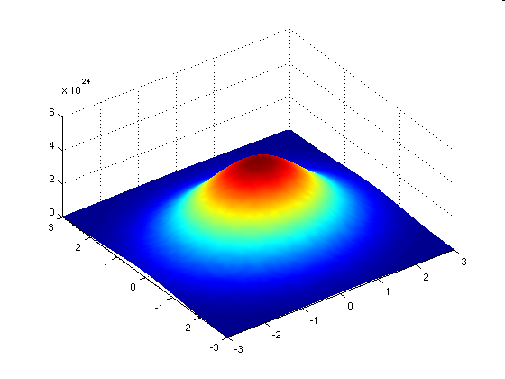
Pavel Kordík, Data Mining lecture, FEL, ČVUT, 2009
Σ
Σ
Notes:
- 2D Gaussian

Slide 14
The basic architecture for a RBF is a 3-layer network.
The input layer is simply a fan-out layer and does no processing.
The hidden layer performs a non-linear mapping from the input space into a (usually) higher dimensional space in which the patterns become linearly separable.
The output layer performs a simple weighted sum (i.e. w∙x).
If the RBFN is used for regression then this output is fine.
However, if pattern classification is required, then a hard-limiter or sigmoid function could be placed on the output neurons to give 0/1 output values

Slide 15
Clustering
The unique feature of the RBF network is the process performed in the hidden layer.
The idea is that the patterns in the input space form clusters.
If the centres of these clusters are known, then the distance from the cluster centre can be measured.

Slide 16
Furthermore, this distance measure is made non-linear, so that if a pattern is in an area that is close to a cluster centre it gives a value close to 1.
Beyond this area, the value drops dramatically.
The notion is that this area is radially symmetrical around the cluster centre, so that the non-linear function becomes known as the radial-basis function.
non-linearly transformed distance
distance from the center of the cluster

Slide 17
RBFN for classification
Category 1
Category 1
Category 2
Category 2
Σ
Σ

Slide 18
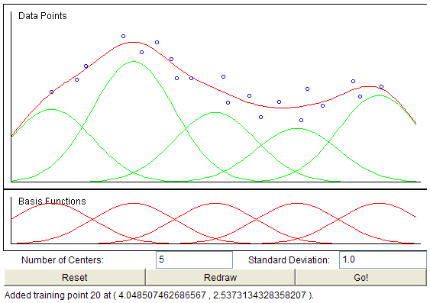
RBFN for regression
http://diwww.epfl.ch/mantra/tutorial/english/rbf/html/

Slide 19
XOR problem
1
0
0
1
Notes:
- 0,0 and 1,1 gives 0 as output

Slide 20
XOR problem
2 inputs x₁, x₂, 2 hidden units (with outputs φ₁, φ₂), one output
The parameters for two hidden units are set as
c₁ = <0,0>, c₂ = <1,1>
the value of radius r is chosen such that 2r² = 1
h₁
x₁ | x₂ | φ₁ | φ₂
0 | 0 | 1 | 0.1
0 | 1 | 0.4 | 0.4
1 | 0 | 0.4 | 0.4
1 | 1 | 0.1 | 1
x₁
φ₁
x₂
φ₂
h₂

Slide 21
1
0,1
1,1
1
1,1
0,1
1,0
0,0
0
0,0
1,0
0
0
1
0
1
When mapped into the feature space < h₁ , h₂ >, two classes become linearly separable. So a linear classifier with h₁(x) and h₂(x) as inputs can be used to solve the XOR problem.
Linear classifier is represented by the output layer.
x₁ | x₂ | φ₁ | φ₂
0 | 0 | 1 | 0.1
0 | 1 | 0.4 | 0.4
1 | 0 | 0.4 | 0.4
1 | 1 | 0.1 | 1
Notes:
- 0,0 and 1,1 gives 0 as output

Slide 22
RBF Learning
Design decision
number of hidden neurons
max of neurons = number of input patterns
min of neurons = determine
more neurons – more complex, smaller tolerance
Parameters to be learnt
centers
radii
A hidden neuron is more sensitive to data points near its center. This sensitivity may be tuned by adjusting the radius.
smaller radius ⇒ fits training data better (overfitting)
larger radius ⇒ less sensitivity, less overfitting, network of smaller size, faster execution
weights between hidden and output layers

Slide 23
Learning can be divide into two independent tasks:
Center and radii determination
Learning of output layer weights
Learning strategies for RBF parameters
Sample center position randomly from the training data
Self-organized selection of centers
Both layers are learnt using supervised learning

Slide 24
Select centers at random
Choose centers randomly from the training set.
Radius r is calculated as
Weights are found by means of numerical linear algebra approach.
Requires a large training set for a satisfactory level of performance.

Slide 25
Self-organized selection of centers
centers are selected using k-means clustering algorithm
radii are usually found using k-NN
find k-nearest centers
The root-mean squared distance between the current cluster centre and its k (typically 2) nearest neighbours is calculated, and this is the value chosen for r.
The output layer is learnt using a gradient descent technique

Slide 26
Supervised learning
Supervised learning of all parameters (centers, radii, weights) using gradient descent.
Mathematical formulas for updating all of these parameters. They are not shown here, it is not necessary to scare you in such a “nice” day.
Learning rate is used.

Slide 27
Advantages/disadvantages
RBFN trains faster than a MLP
Although the RBFN is quick to train, when training is finished and it is being used it is slower than a MLP.
RBFN are essentially well tried statistical techniques being presented as neural networks. Learning mechanisms in statistical neural networks are not biologically plausible.
RBFN can give “I don’t know” answer.
RBFN construct local approximations to non-linear I/O mapping. MLP construct global approximations to non-linear I/O mapping.

